Slide 1


Social Buzz Analysis

Slide 2


Today's agenda
Project recap
Problem
The Analytics team
Process
Insights
Summary

Slide 3

Social Buzz is a fast growing technology unicorn
that needs to adapt quickly to it’s global scale.
Accenture has begun a 3 month POC focussing on these tasks:
An audit of Social Buzz’s big data practice.
Reccomendation for a succesful IPO.
Analysis to find Social Buzz’s top 5 most
popular caegories of content.
Project Recap

Slide 4


Problem
Over 100000 posts per day
36,500,000 pieces of content
per year!
But how to capitalize it when there is so much?
-We can find which data is more useful.
Hence we do Analysis to find Social Buzz’s top 5 most popular categories of content

Slide 5




Andrew Fleming
Chief Technical Architect
The Analytics team
Marcus Rompton
Senior Principle
Karandeep singh Sidhu
Data Analyst

Slide 6
Process
1
Data understanding
2
Data Cleaning
3
Data Modelling
4
Data Analysis
5
Uncover Insights

Slide 7

Insights
Aninals
most popular category
Top 5 categories
costiutes 36% of total score.
May
Most Posts

Slide 8
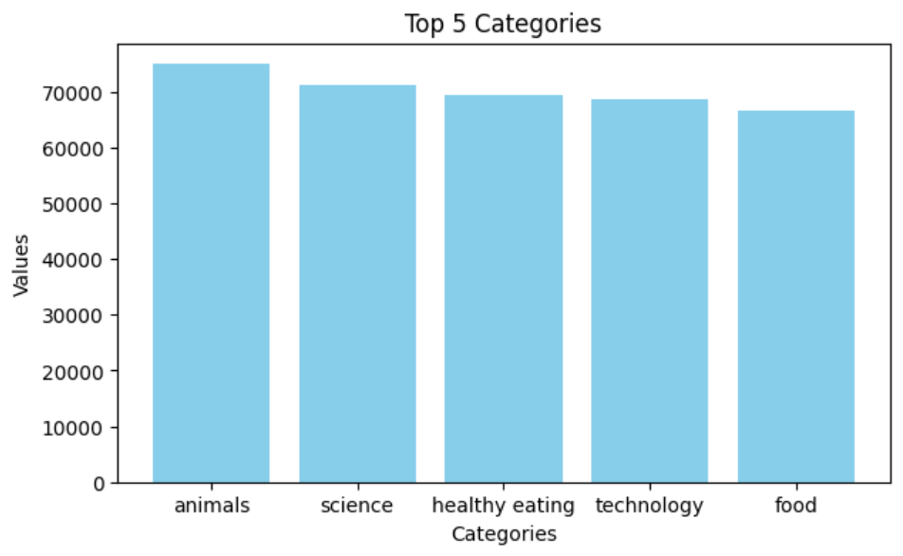

Slide 9
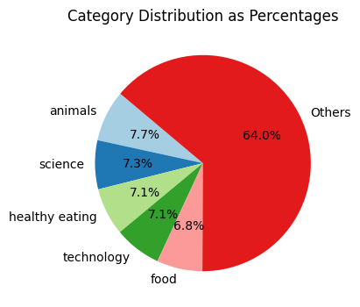
Top 5 categories constitutes 36% of the total data.
The individual top categories have relatively similar proportions, each ranging between 6.8% to 7.7%.

Slide 10

Top Content Categories: The analysis revealed that Animals, Science, Healthy Eating, Technology, and Food are the most engaging content categories on Social Buzz.
Significant Share:These top 5 categories collectively account for 36% of the total content engagement.
Balanced Distribution: Each of these top categories has a similar share of engagement, ranging from 6.8% to 7.7%.
Strategic Focus: Insights from this analysis will guide Social Buzz in prioritizing content strategies to maximize user engagement and growth.
Summary

Slide 11

Thank you!
ANY QUESTIONS?

